Slide 1


MOT 131A Emerging and Breakthrough Technologies
Prof. dr. J. Roland Ortt
Lecture 2: innovation process project-level

Slide 2
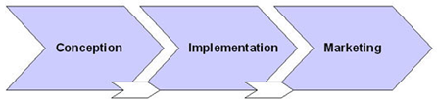
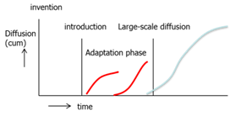
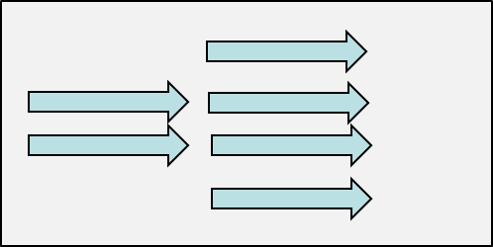
Key messages from the previous lecture
Levels
1. Project level
2. Pattern level development/diffusion
3. Discipline level
Message 1: Innovation process = multi-level phenomenon
Focus MOT2421: Technological innovation as a complex phenomenon
Many actors & factors interact over time
Company perspective.
At different levels.

Slide 3
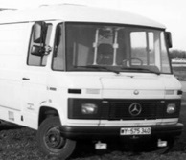
Focus MOT131A: Technological innovation as a complex phenomenon
Many actors factors interact over time: company perspective.
At different levels
Levels | Unit focus | Boundary | Outcome | Example
1. Project level | Product version (years) (e.g. Samsung mobile phone) | Organization or network of organizations collaborating on one innovation | Innovation 1 = New product version + - Marketing-mix - Organization - Supply chain | Dickmann’s Van project
2. Technology level | Generic product (decades) (e.g. mobile phone in general) | Cluster of organizations in industry in parallel or in sequence working on similar innovation | Innovation 2 = New type of product (generic)= ∑ Innovation 1i + - Complementary p/s - Network of org’s - Customers - Institutions | Pattern for Autonomous vehicles; pattern for autonomous ships.
3. multi-technology level | Set of related technologies (century) (e.g. tele- communication) | Industry, (or a combination of industries) Multiple clusters of organizations working on related products | Inventions and New patterns How patterns influence each other and can be combined in new patterns | Autonomous systems (cars, ships, submarines, drones, robots, etc)

Slide 4
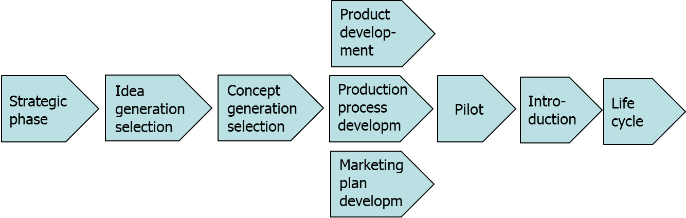
Message 2: Forgotten phases in project-
level innovation process
Innovation on the project-level:
Typical stages that tend to be forgotten
Strategic phase: innovate or not
Life cycle improvements after first intro

Slide 5

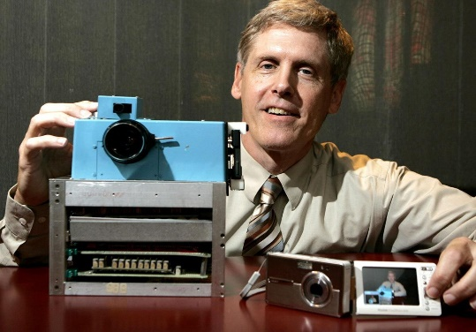
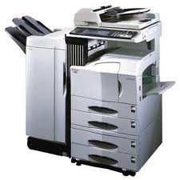
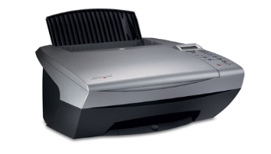
Message 3: Innovation is more
than a new product
Project-level: Innovation 1
= New product version +
Service 5. Supply chain
Production (Fitting in broader
Marketing-mix market context)
Organization
Some companies cannot introduce (their own)
invention or innovation!

Slide 6
Reading material: innovation projects (part 2)
Study material
Article: Cooper (1990) article on the stage-gate process
Article: Szalvay (2004) on agile software development
Article: Different approaches to cope with the same trends
Article: The evolution of innovation management over time
Article: Contextual Innovation Management

Slide 7
Announcements
Assignment in lecture 3
Enroll in a group
Planning Friday morning
08.45-10.30
10.30-11.30
11.30
17.00
New course
"Are you interested in start-ups?”
information sessions about the master-elective course on 11th or the 14th during lunch (12:45). This course is 6 ECTS and every interested masterstudent can enroll. For the information session you can register via this link:
https://forms.gle/KpUm1NHbnjjxvkp78
Are you already excited to enroll? Then you can fill out this form:
https://forms.gle/LC2WsZAAF7ffcstJ7”

Slide 8
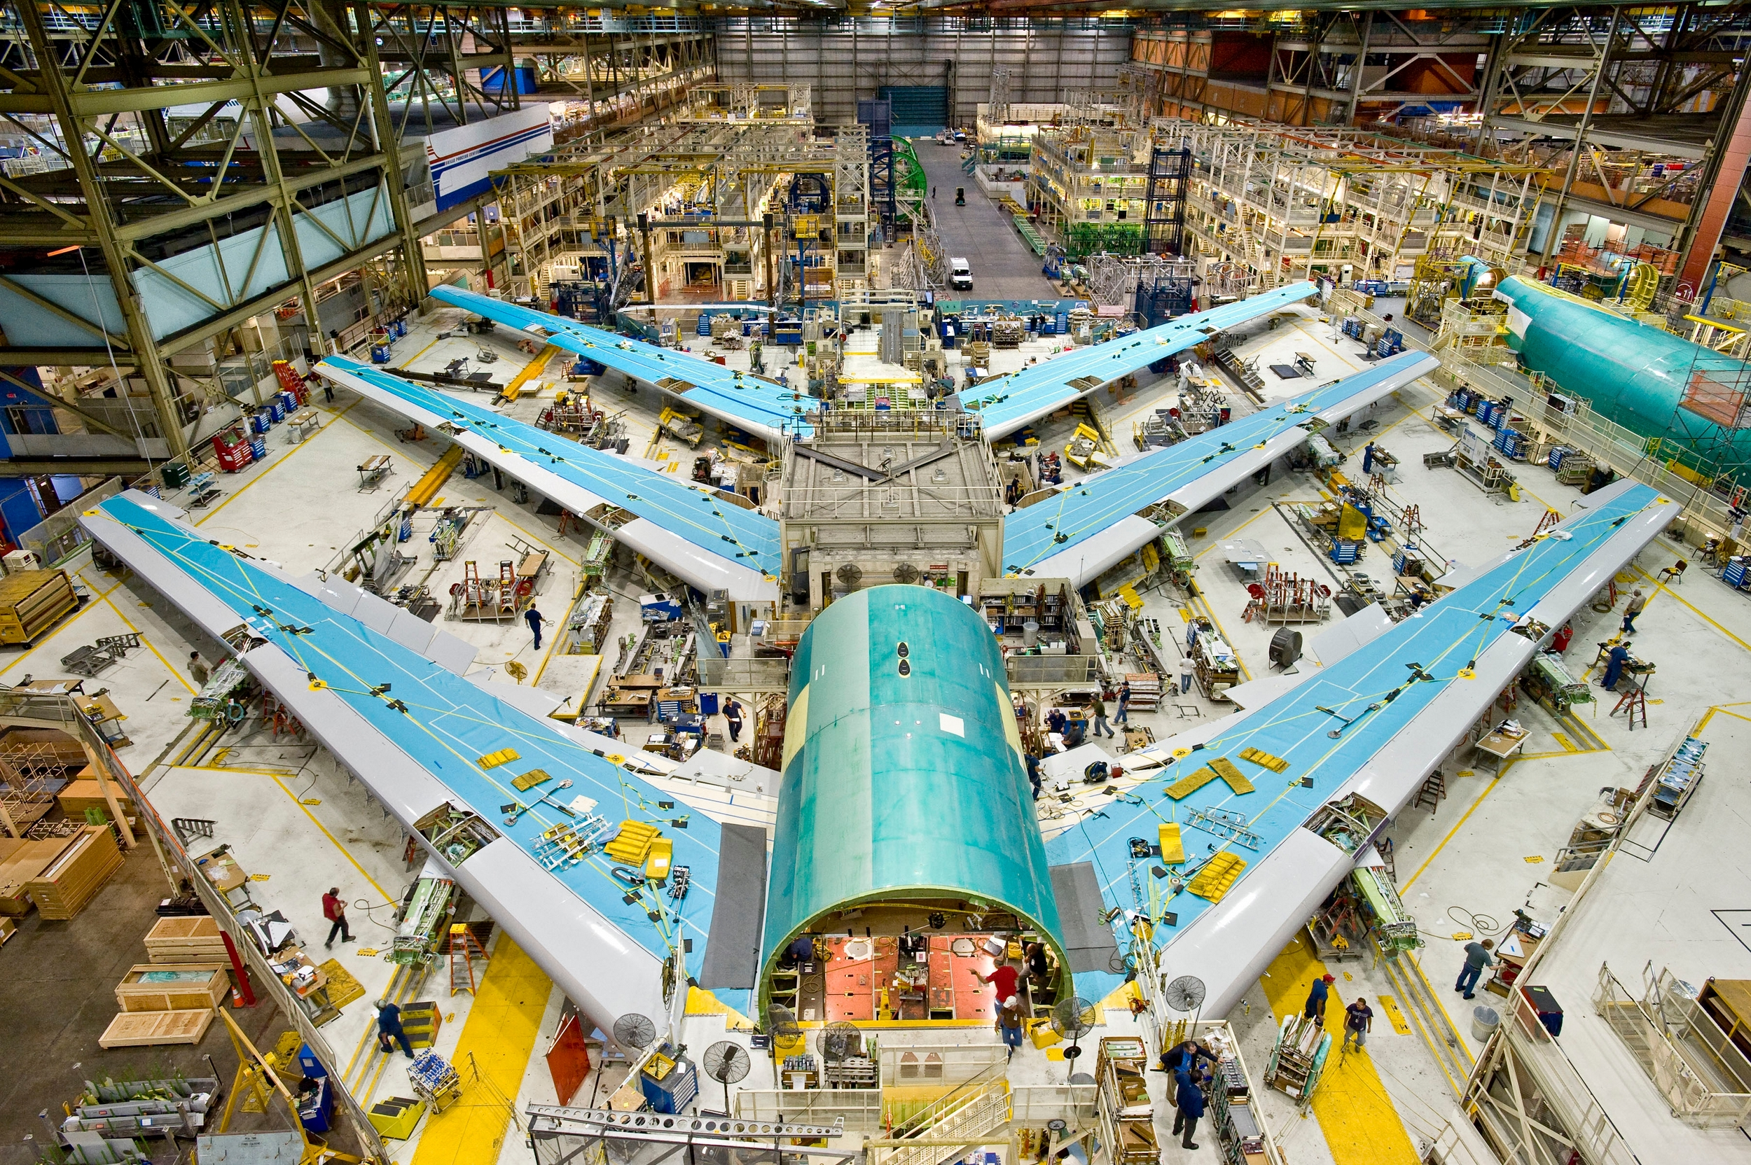
Lecture 2 and 3 project-level
Project aspects
Overview types of innovation projects
Stage-gate
Scrum
Comparison
Product innovation and its alternatives
Evolution of thinking about innovation
Contextual innovation management
Guest lecture
Assignment 1

Slide 9
MOT 2421 Contents Today
Topic | Source to study
Overview innovation projects | slides
Stage-gate | Cooper (1990) article on the stage-gate process
Scrum | Szalvay (2004) on agile software development
Comparison | Different approaches to cope with the same trends
Product innovation and its alternatives | slides
Evolution of thinking about innovation | The evolution of innovation management over time
Contextual innovation management | Contextual Innovation Management

Slide 10
Overview types of innovation projects
Design – Build process
Stage gate process
Agile – Scrum process
Trial and error (Bricolage) process
Platform development process
…..

Slide 11

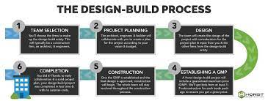
Design-Bid-Build | Design-Build
Step Step | Step Step
https://www.horstconstruction.com/news-and-blog/design-build-construction-defined-the-team-process-examples/
https://www.northernconstruction.com/blog/what-are-the-stages-of-a-construction-project/
Notes:
Maybe do use a deliberately more innovative and unique civilian construction that is actually an innovation.

Slide 12
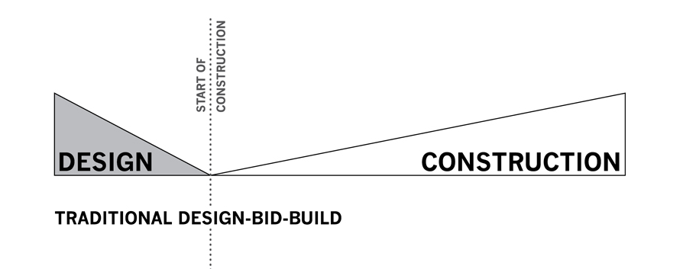
Design – Build process
“The design–build procurement route changes the traditional sequence of work. It answers the client's wishes for a single point of responsibility in an attempt to reduce risks and overall costs. Although the use of subcontractors to complete more specialized work is common, the design-build contractor remains the primary contact and primary force behind the work. It is now commonly used in many countries and forms of contracts are widely available.”
History of these approaches
https://en.wikipedia.org/wiki/Design%E2%80%93build

Slide 13
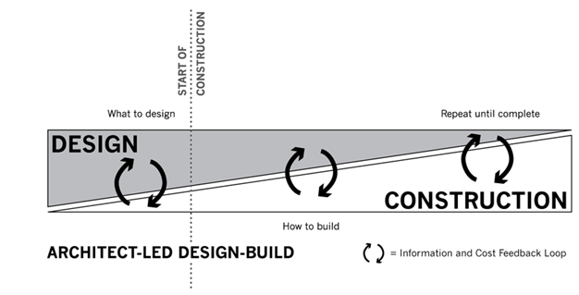

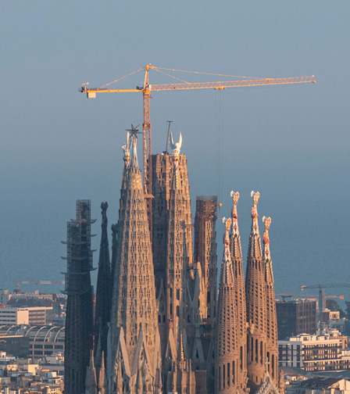
Notes:
Maybe do use a deliberately more innovative and unique civilian construction that is actually an innovation.

Slide 14


https://ace.electronicsforu.com/opportunities/professional-consumer-electronics-market-will-grow-more-than-personal-report/
https://www.pngegg.com/en/png-hhore

Slide 15
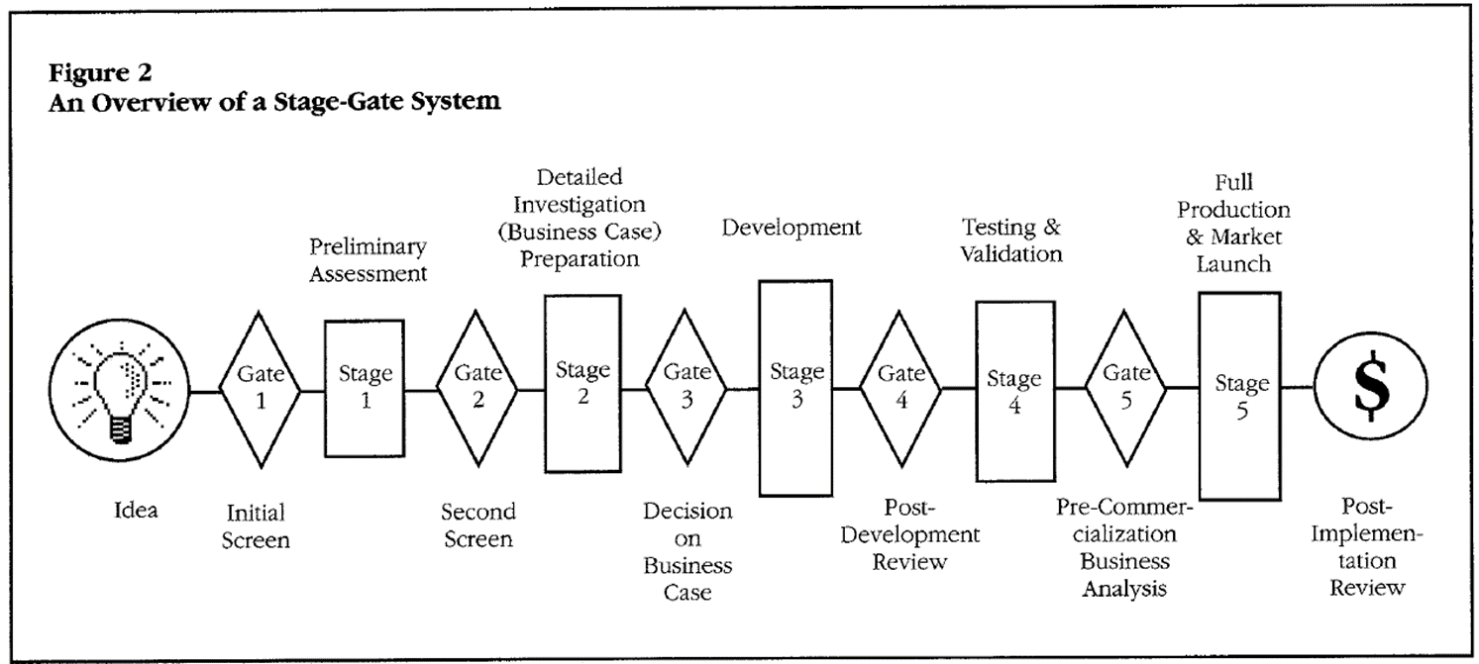
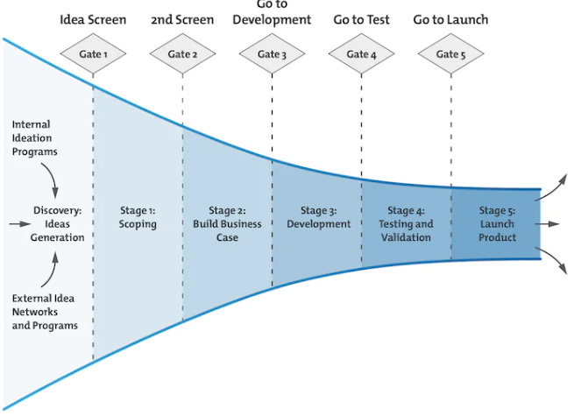
2. Stage gate process
Funnel (early late selection)
Open innovation
(open vs closed funnel)

Slide 16


Slide 17
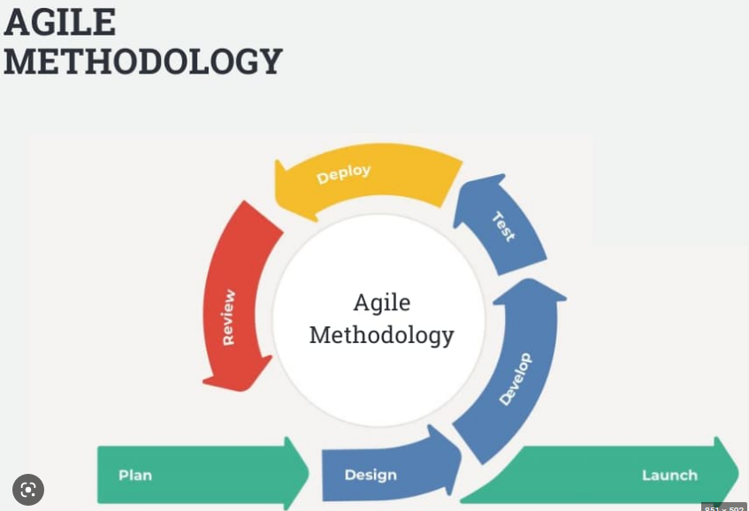
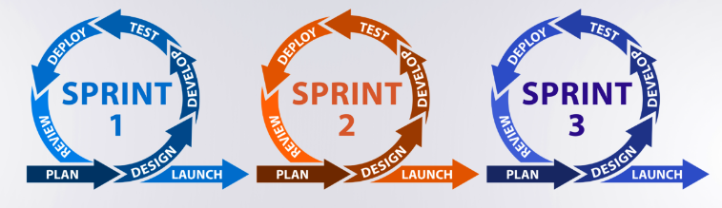
3. Agile – Scrum process
https://interqualitybg.com/en/resources/scrum-and-agile-resources/agile-methodology
https://kruschecompany.com/agile-software-development/

Slide 18
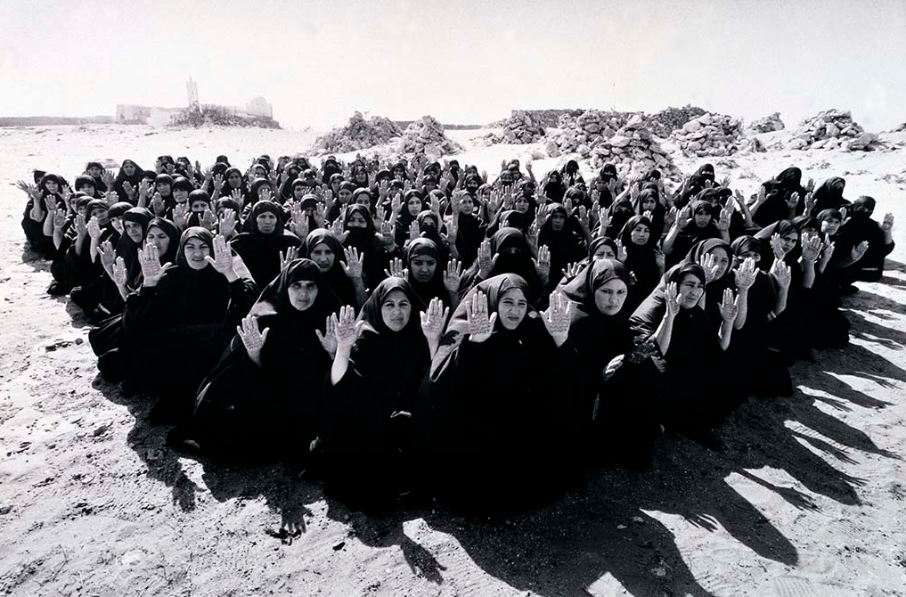
Shirin Neshat

Slide 19
4. Trial and error (Bricolage)
Visual arts[edit]
The visual arts is a field in which individuals often integrate a variety of knowledge sets in order to produce inventive work. To reach this stage, artists read print materials across a wide array of disciplines, as well as information from their own social identities.^{[21]} For instance, the artist Shirin Neshat has integrated her identities as an Iranian exile and a woman in order to make complex, creative and critical bodies of work.^{[22]} This willingness to integrate diverse knowledge sets enables artists with multiple identities to fully leverage their knowledge sets. This is demonstrated by Jeffrey Sanchez-Burks, Chi-Ying Chen and Fiona Lee, who found that individuals were shown to exhibit greater levels of innovation in tasks related to their cultural identities when they successfully integrated those identities.^{[23]}
https://en.wikipedia.org/wiki/Bricolage
Full article: CHENG, Chi-Ying; SANCHEZ-BURKS, Jeffrey; and LEE, Fiona, "Increasing innovation through identity integration." (2007). Research Collection School of Social Sciences. Paper 2139. https://ink.library.smu.edu.sg/soss_research/2139
Information systems[edit]
In information systems, bricolage is used by Claudio Ciborra to describe the way in which strategic information systems (SIS) can be built in order to maintain successful competitive advantage over a longer period of time than standard SIS. By valuing tinkering and allowing SIS to evolve from the bottom-up, rather than implementing it from the top-down, the firm will end up with something that is deeply rooted in the organisational culture that is specific to that firm and is much less easily imitated.^{[19]}
https://en.wikipedia.org/wiki/Bricolage
Full article: Ciborra, C. U. (1992). From thinking to tinkering: The grassroots of strategic information systems. The information society, 8(4), 297-309.

Slide 20
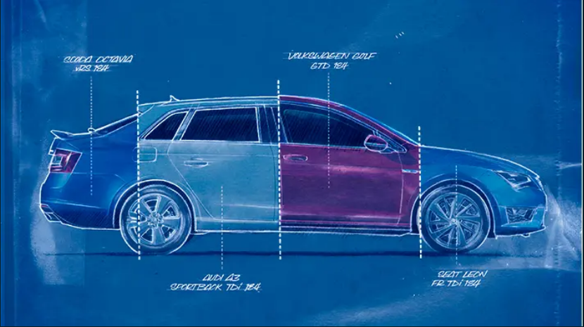


Slide 21
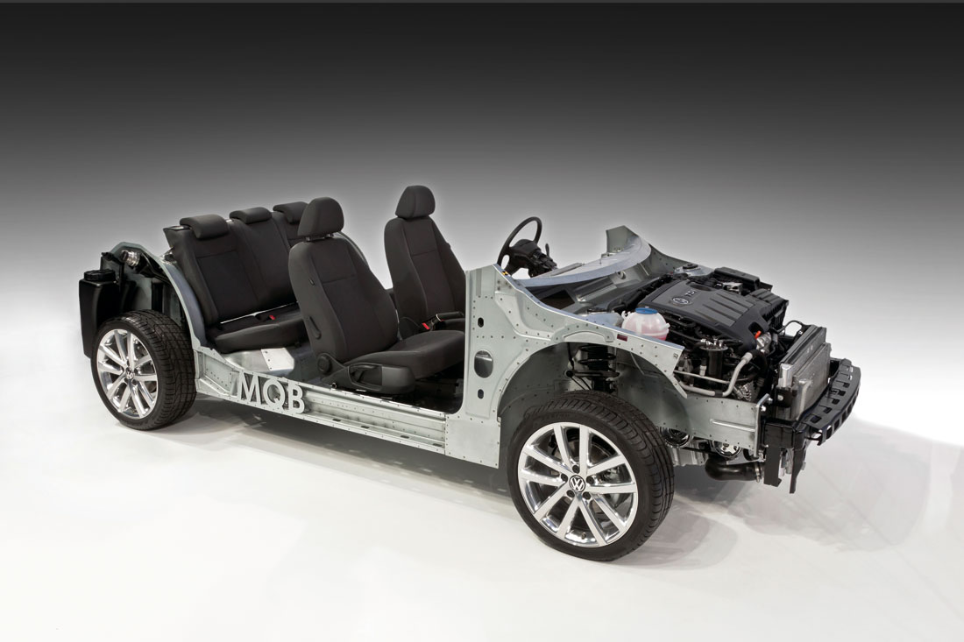
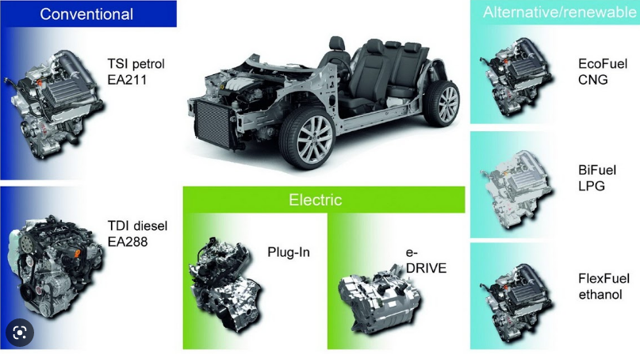
5. Platform development process
Different cars (VW, Audi, Skoda, Seat,
Different designs over time fitting in the platform
Basis + all possible modules

Slide 22
Type of innovation projects contrasted
 | Type project | Structure of project | Evolution of idea/concept during process | Organization around project | Type of innovation | Staring conditions
1 | Design – Build | Stages; focus on pre-specified innovation | Minimal. Design is specified fully prior to construction. | One main contractor, possibly sub-contractors | Building, bridge, railway track, … | One customer; Requirements, process and outcome known upfront.
2 | Stage-gate | Stages; focus on innovation meeting pre-set requirements | A lot of variants funnelled towards one (a few) innovation(s) | One multi-disciplinary project-team, mostly from matrix organization; | Household electronics, … | Segment of customers; Requirements, process, stages known, outcome unknown.
3 | Agile Scrum | Rounds; focus on process to meet general goal | Variation from minimum viable concept with first functionality to complete system with extended functionality | Agile/scrum team members can be from network, or different parts of main organization. | Software, complex unique systems, … | Usually one main customer; Requirements uncertain, process set, outcome
4 | Trial and error (Bricolage) | Iterative unspecified process | Can be large, from one conceptual idea to the other and from one innovation to the next. | Small teams, sometimes individuals (artists, inventors, scientists) | Art, technological inventions, complex systems | Requirements, process, and outcome uncertain
5 | Platform | Two developments: platform and later on innovation based on platform | Upfront in the specification of platform, many innovation variants are possible. | One team to create platform, another team to create innovations on the platform. | Cars, equipment, and other modular systems on one shared basis | Platform allows large variation but the platform itself needs to be stable for long.
6 | ?
Notes:
Indicate that the first 5 types of innovation process are described from the perspective of a company. Other categories of innovation processes involve such processes in a political environment. In that environment the process will change fundamentally:
The decision to innovate is a key decision (where multiple stakeholders need to agree)
The process will involve contact with these stakeholders in subsequent phases (communication next to market and technology info) is important.
The life cycle stage will be important again.

Slide 23
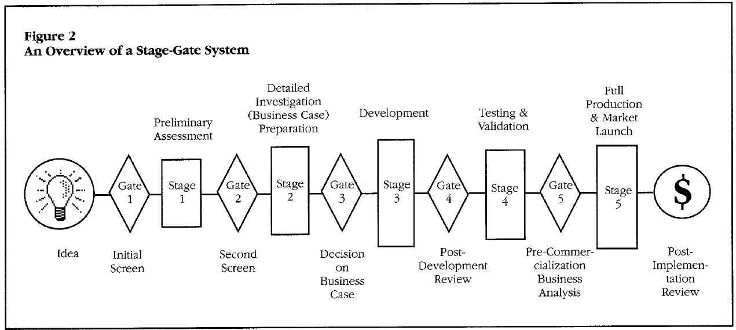
Project aspects of the innovation process
1. Stage gate innovation project (a)
Stage-gate
Scrum
Comparison
Product innovation and its alternatives
Evolution of thinking about innovation
Contextual innovation management
1 stage | 2 scrum | 3 compare | 4 alternatives | 5 evolution | 6 contextual
Notes:
Open question:
What are the phases of an npd process?
Build up this process in discussion with the group and discuss the activities in each phase.
Lessons
First phase, strategic phase, is often omitted
Last phase, life cycle management, is often omitted.
Parts in d.e.f. can be scheduled in parallel
Relations between product/production development and marketing plan
Product modular - Production process in batches to make these modules (market-driven numbers) and separate assembling - Marketing (on demand production/ assembling via internet or other channel)
Standard product - Production process standard (economies of scale) – Marketing via retail or other channel
Complicated product with service repair requirements and learning – Production process standard (economies of scale) – Marketing via shop/experts and so on.
Examples
The more unique the product the more production is affected.
Parallel activities require some proper design of a concept
The logic combination of the type of product, type of production and type of marketing, should be formulated already in the concept stage. If this is not done well, the three parallel processes (or the three sequential processes) will continue to affect each other and thereby a chaotic process of constant iterations will emerge. (compare this with thesis process)

Slide 24
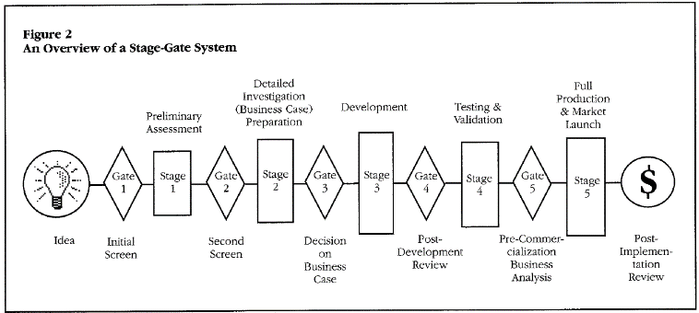
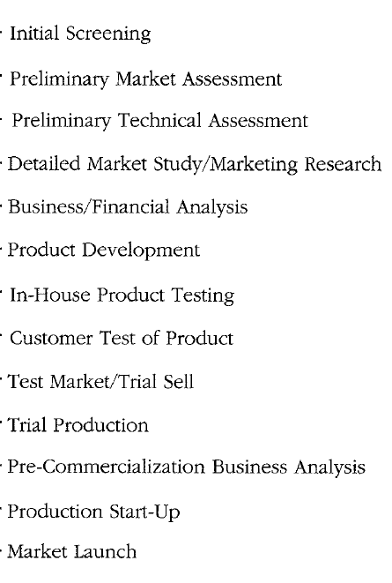
Project aspects of the innovation process
1. Stage gate innovation project (b)
Activities are divided in stages: Stage-gate approach claims that good process consists of a complete set of (13) activities.
Between stages are gates: At each gate inputs are evaluated using criteria and that yields an output (decision mngt). Four decisions are possible: Go, Kill, Hold, Recycle (store?)
Results of this stage-gate project: Higher success rate More senior/top management involvement (gate) More market orientation More focus on pre-development activities Explicit evaluation, quality of execution
Anything missing?
Notes:
Questions
How (when, in what situation) to decide at the end of a phase whether it is …..
GO (go to next phase)
KILL (project is stopped entirely)
(if project has no potential and a parallel (alternative) project is having potential) (if project has potential yet organization is in deep trouble, or re-organization)
HOLD (extend phase to complete and meet expectations/requirements) (resource or scheduling problem caused a delay)
RECYCLE (redo the phase)
Criticism on stages
Lack of portfolio perspective in which intermediate results or modules that are developed can be used in other projects or even can be used to sell (open innovation) or can be stored (with a notification when the innovation can be further developed). Also an iteration to go back multiple phases does not seem an option in the standard stage-gate procedure.
Who is evaluating this?
Project members
Peers
Managers
External stakeholders (customers?)
External experts
Combinations of these actors
Other …

Slide 25
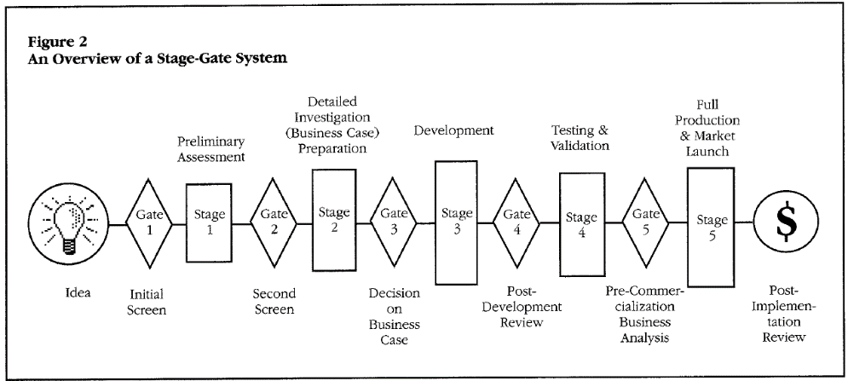
Project aspects of the innovation process
1. Stage gate innovation project (c)
Discussion points regarding the stage-gate process
Is the process complete (stages missing)?
Where is market and technology information?
Organizational consequences?
Sequential or also parallel processes?
Prescribed process or also adaptable process?
1 stage | 2 scrum | 3 compare | 4 alternatives | 5 evolution | 6 contextual

Slide 26

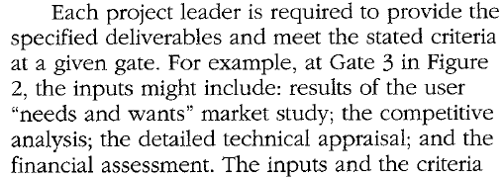
Project aspects of the innovation process
1. Stage gate innovation project (d)
Discussion points regarding the stage-gate process
Is the process complete (stages missing)?
Decision to innovate and life cycle management?
Where is market and technology information?
(p.46)
1 stage | 2 scrum | 3 compare | 4 alternatives | 5 evolution | 6 contextual

Slide 27
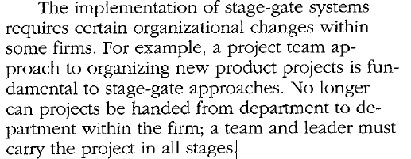
Project aspects of the innovation process
1. Stage gate innovation project (e)
Discussion points regarding the stage-gate process
Organizational consequences?
Sequential or also parallel processes?
Sequential regarding stages, parallel within the stages
Prescribed process or also adaptable process?
Same basic process, variations across companies, industries
1 stage | 2 scrum | 3 compare | 4 alternatives | 5 evolution | 6 contextual

Slide 28
Lecture 2 and 3 project-level
Project aspects
Overview types of innovation projects
Stage-gate
Scrum
Comparison
Product innovation and its alternatives
Evolution of thinking about innovation
Contextual innovation management
Guest lecture
Assignment 1

Slide 29
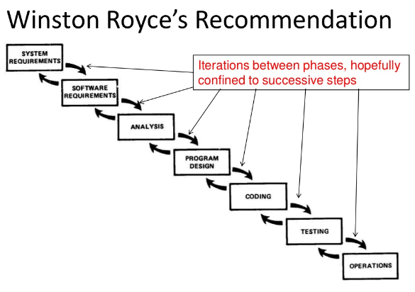
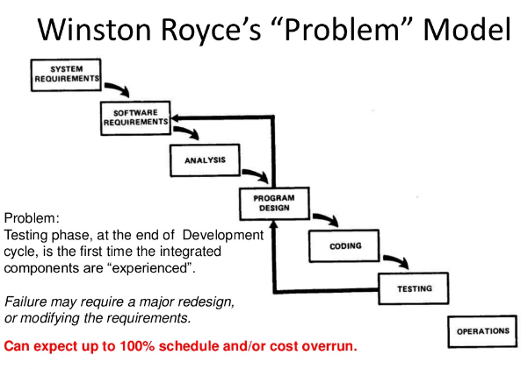
Project aspects of the innovation process
2. SCRUM innovation project (a)
Start: linear software development process
Problems
Requirements must be known upfront.
Testing is at the end
1 stage | 2 scrum | 3 compare | 4 alternatives | 5 evolution | 6 contextual
Source: http://www.slideshare.net/fullscreen/wasitova/pmbok-and-scrum-can-we-be-friends/
(2016-04-23)
Notes:
Requirements are not known upfront by customers.
Consequence:
Too many requirements without ranking (leading towards too many never used features)
Wrong requirements or incomplete ones requireing expensive and time-consuming iterations
Testing or use of early ideas and concepts (paper and pencil versions do make requirements explicit
(you know what you want after you see it in practice)
Another reason for iterations is that the stakeholders (problem owner or customer) often themselves do consiste of multiple persons, divided in coalitions with different interests and perspectives. This makes the decision-making process even more political and hence complex.

Slide 30
Project aspects of the innovation process
2. SCRUM innovation project (b)
System software requirements
Analysis
Design
Coding
Testing
Operation
use
use
1 stage | 2 scrum | 3 compare | 4 alternatives | 5 evolution | 6 contextual

Slide 31
Project aspects of the innovation process
2. SCRUM innovation project (b)
https://kruschecompany.com/agile-software-development/
1 stage | 2 scrum | 3 compare | 4 alternatives | 5 evolution | 6 contextual

Slide 32
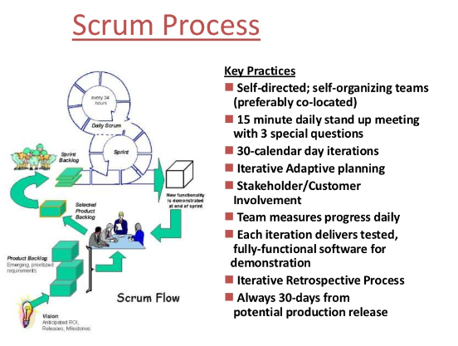
Project aspects of the innovation process
2. SCRUM innovation project (c)
0 Intro | 1 Project | 2 Portfolio | 3 Changes | 4 Assignment
Source: http://www.slideshare.net/fullscreen/wasitova/pmbok-and-scrum-can-we-be-friends/
(2016-04-23)
Notes:
Comments:
Example: brown paper roll
Each of these “rules” have a logic reason and can have a very positive effect if you understand the idea behind the rule. If so, you can adapt the method.
If rules are not understood, and the rules are slavishly followed, the set of rules become a ceremony.
Conclusion:
Always understand why rules make sense, and when you should apply, adapt or abolish them.

Slide 33
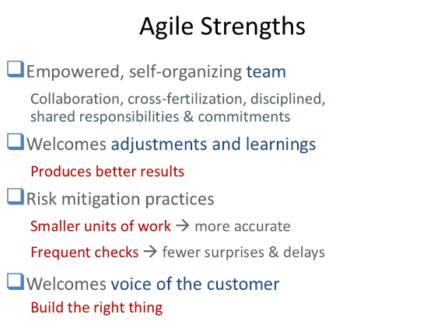
Project aspects of the innovation process
2. SCRUM innovation project (d)
Agile limitations?
Innovation needs to be a system that can be decomposed in subsystems, each of which can be designed separately (Platform with modules)
Agile does not apply to simple (design-construct type of) projects. That is by the way explicitly mentioned in agile documentation.
It is difficult to stop the iterations because requirements keep on changing (and end-result is never perfect)
Scale up of many projects in a larger program or corporation can become difficult if teams are self-organizing.
Agile may limit the paper work (administrative burden for the project team)
1 stage | 2 scrum | 3 compare | 4 alternatives | 5 evolution | 6 contextual
Source: http://www.slideshare.net/fullscreen/wasitova/pmbok-and-scrum-can-we-be-friends/
(2016-04-23)
Notes:
Scaled agile
https://www.scaledagile.com/enterprise-solutions/what-is-safe/

Slide 34
Project aspects of the innovation process
3. Comparing Stage-gate and Scrum
 | Stage-gate | Scrum
Starting conditions | Innovation requirements are know upfront | Requirements are not (all) known upfront.
 | Innovation can be both modular or can be one coherent system (without clear modules/parts) | Innovation needs to be modular or can be split up in parts.
Evolution of idea /concept during process | Selection (selection is possible using the known requirements): From many ideas to one product; Growth: Ideas cover almost all aspects, these aspects are elaborated over time (all parts from the beginning) for the selected ideas/concepts/product variants. | Selection is now hardly possible because selection criteria (requirements) are not known; Growth: From module completed to next module (part after part).
Structure project | Linear stages with gates. (The more specified upfront, the more activities can be scheduled in parallel) | Development of modules in cycles or “sub-projects”.
Organization | Management (gates), project leader and team (in stages) | Scrum master and team members (self-directed), customer/problem-owner (after 30 days).
Process | No prescribed rhythm (plan-dependent) (process is specified in terms of results per phase yet timing depends on project plan) | Daily rhythm, 30-day (month) rhythm (process rhythm helps to deal with uncertainty)
Flexibility | Overall plan is created upfront, (limited) changes are possible after each stage. | Plan is made per run of 30 days. Changes and new insights are welcomed and searched for.
Implementation | Implementation is at the end with handover. | Implementation can be done per module.
1 Intro | 2 Braidlock | 3 Project | 4 Portfolio | 5 Evolution
Notes:
Addition (remark made by student Tanya)
The context in which Stage-gate versus Agile/SCRUM emerged.
Stage-gate is proposed in the US in the 1980s. At that time the PDMA (association of companies that want to exchange and create knowledge, tools and practices regarding new product development. The majority of the companies is developing high tech systems or rather complicated products (electronic equipment, cars, engines, and so on).
In another culture, in Japan, a very simple cycle is proposed to develop. This approach is closer to agile (sprints)
Plan
Do
Check
Act
Re-plan
(and so on) Furthermore in Japan many incremental steps are implemented and overall may have a radical effect (cycles).
In another Industry (later on in time) the IT industry the idea of agile projects emerged.
Context refers to
type of culture (US versus Japan)
Time frame (1980s versus 2000s)
Industry (hardware technological systems versus software)
Conclusion:
If you really want to understand an approach, value it and see it limitations then go back to its original context (what was the context in which the apporach made sense?)
Then formulate assumptions with which you can decide when to use and not to use an approach.

Slide 35




Project aspects of the innovation process
3. Comparing Stage-gate and Scrum
1 Selection versus growth
2 All aspects from beginning or not?
1 Intro | 2 Braidlock | 3 Project | 4 Portfolio | 5 Evolution

Slide 36
Project aspects of the innovation process
3. What to do when Stage-gate and Scrum fail
Stage-gate requires that you have some starting point for ideation after innovation is chosen as a strategy: unmet needs, competitive technology, product/market combination to focus at, a problem formulated by a business customer, etcetera. Requirements are known upfront.
If not available start with an exploration project to explore scenario’s and then decide about npd-project later on with customer.
Scrum requires that you have an initial requirement to start working on a subsystem.
If not available start with exploring the system and after that define a Scrum-project.
1 stage | 2 scrum | 3 compare | 4 alternatives | 5 evolution | 6 contextual
Source: http://www.slideshare.net/fullscreen/wasitova/pmbok-and-scrum-can-we-be-friends/
(2016-04-23)

Slide 37
Lecture 2 and 3 project-level
Project aspects
Overview types of innovation projects
Stage-gate
Scrum
Comparison
Product innovation and its alternatives
Evolution of thinking about innovation
Contextual innovation management
Guest lecture
Assignment 1

Slide 38

Questions?

